Slide 1
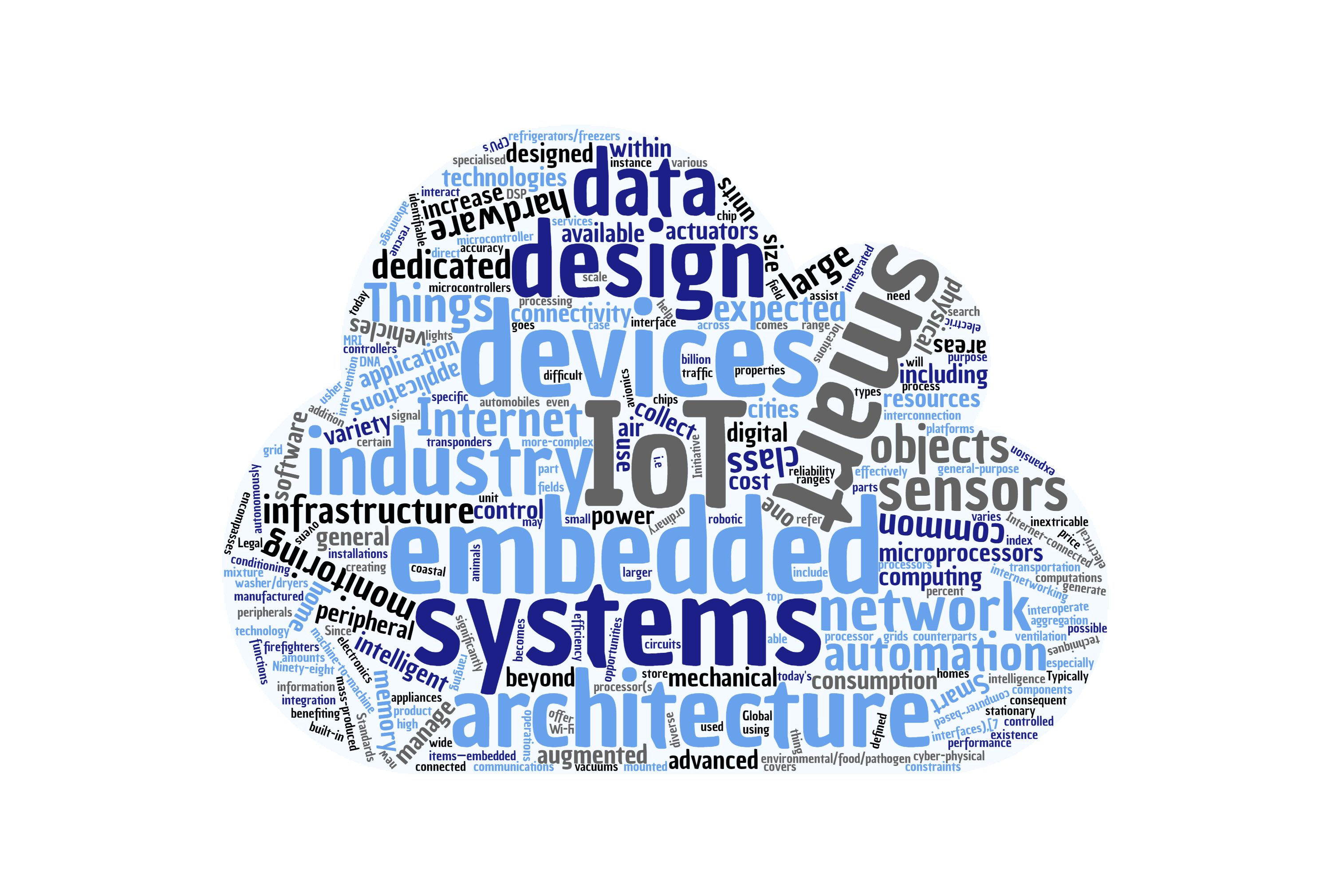
Authentication & Authorization Mechanisms in the Web of Things Monika Singh monika.singh@tum.de

Slide 2
Content
Web of Things
Introduction
Things Description
Security Mechanism
BasicSecuritySchema
DigestSecuritySchema
APIKeySecuritySchema
PSKSecuritySchema
BearerSecuritySchema

Slide 3

WoT-Web of Things
Joining the distributed IoT by using the existing web technologies
Set of standards formed by the world wide web consortium (W3C) to facilitate the
Interoperability
Fragmentation
usability
of the Internet of Things (IoT) [wot]
Preserve and complement existing IoT solutions
Easier to integrate
Easier to maintain larger systems

Slide 4
WoT-Things Descriptions
Entry point of the things
provides a machine-readable data format for describing the metadata and network-facing interfaces of Things[wot]
4 main component:
Metadata to describe the Thing
Interaction for the things
Property
Action
Event
Data schema (like array, boolean, object etc)
Links to describe any relation to the other Things
Security schema

Slide 5



WoT-Web of Things: Example
tooDry
tooWet
Air Temperature
State
Notify the subscribers
Read, write,
observe, Unobserve Property
Subscribe, unsubscribe event
Consumer
Start Sprinkler
Stop Sprinkler
Invoke Action

Slide 6

Security Mechanisms

Slide 7
Security Schemes: BasicSecurityScheme
Uses user-id/password pairs (encoded in Base64)
Common use is identification purpose like statistics of users
Not secure
Can be used with external secure systems like TLS
Attacks like spoofing, eavesdropping etc
Document: [RFC7617]

Slide 8
Security Schemes: DigestSecurityScheme
Client
Server
WWW-Authenticate: Digest
realm="http-auth@example.org", qop="auth, auth-int",
algorithm=SHA-256, nonce="7ypf/xlj9XXwfDPEoM4URrv/xwf94BcCAzFZH4GiTo0v", opaque="FQhe/qaU925kfnzjCev0ciny7QMkPqMAFRtzCUYo5tdS"
Authorization: Digest username="Mufasa",
realm="http-auth@example.org", uri="/dir/index.html",
algorithm=SHA-256, nonce="7ypf/xlj9XXwfDPEoM4URrv/xwf94BcCAzFZH4GiTo0v",
nc=00000001, cnonce="f2/wE4q74E6zIJEtWaHKaf5wv/H5QzzpXusqGemxURZJ",
qop=auth, response="753927fa0e85d155564e2e272a28d1802ca10daf4496794697cf8db5856cb6c1", opaque="FQhe/qaU925kfnzjCev0ciny7QMkPqMAFRtzCUYo5tdS"
Unauthenticated Request
401 Unauthorized with WWW.Authenticate Header
Request with Authorization Header
Verify the credentials
If valid, returns 200
nc: nonce count
qop: quality of protection
Ref: []

Slide 9
Security Schemes: DigestSecurityScheme
Uses user-id/password pairs
Vulernable to dictinary attacks
Entropy of the password should be more like 128 bit hence cannot be memorised by the humans, can be used for automated process
Use over secure channels like https
Inability of the client to authenticate the server is a weakness of Digest Authentication
No confidentiality protection, other response/request available to eavesdropper
Not implemented for HTTP consumer or producer in node-wot
Document : [RFC7616]

Slide 10
Security Schemes: APIKeySecurityScheme
Client has a key, which is sent to the server for verification (same as openWeatherMap)
Simple, quick and easy to verify
Not very secure, attacks like Replay attacks are possible
Only implemented for HTTP consumer in node-wot
Security Schemes: PSKSecurityScheme
Pre-shared key between client and server
Key is used to generate the session key used for TLS
Simple to implement
Keys can get old, need to update it regularly
Should be long and random to avoid brute force attack
Not implemented for HTTP consumer and producer in node-wot

Slide 11
Security Schemes: BearerSecurityScheme
client
Authorization Request
Resource
Owner
Authorization Grant
Authorization Grant
Authorization server
GET /resource HTTP/1.1 Host: server.example.com Authorization: Bearer mF_9.B5f-4.1JqM
Access Token
Access Token
Resource
Server
Protected Resource

Slide 12
Security Schemes: BearerSecurityScheme
Opaque Strings
No proof of possession
Attacks like replay, same token for multiple resource, disclosure
Mitigations
Limited life time of the token
Using TLS for authentication server
Cookies should not be used(plaintext transfer)
Client verification of TLS certificate of server
Document: [RFC6750]

Slide 13
Thank you

Slide 14
References
https://www.w3.org/TR/wot-thing-description [wot]
The 'Basic' HTTP Authentication Scheme. J. Reschke. IETF. September 2015. Proposed Standard. URL: https://httpwg.org/specs/rfc7617.html [RFC7617]
HTTP Digest Access Authentication. R. Shekh-Yusef, Ed.; D. Ahrens; S. Bremer. IETF. September 2015. Proposed Standard. URL: https://httpwg.org/specs/rfc7616.html [RFC7616]
The OAuth 2.0 Authorization Framework: Bearer Token Usage. M. Jones; D. Hardt. IETF. October 2012. Proposed Standard. URL: https://tools.ietf.org/html/rfc6750 [RFC6750]

